Slide 1

IT MISSION REPORT
Promote RPA & IT to minimize indirect job
Auto calculation & Visualization(MPW-EXP)
JAN.21

Slide 2
AGENDA
01
REVIEW 2020
02
ACTION PLAN 2021
Notes:
My report have 4 part.
1st why we use RPA in CVN?
2nd RPA strategy.
3rd Result to now.
Finally next plan.

Slide 3
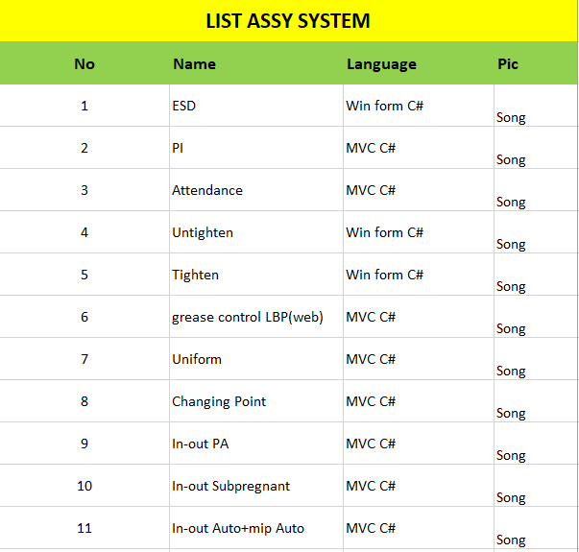
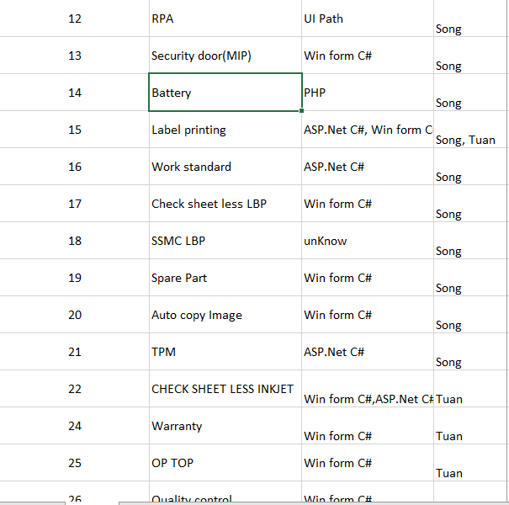
Review 2020
Total: 26 system

Slide 4
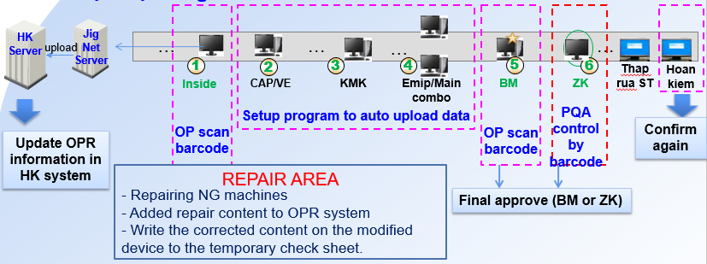
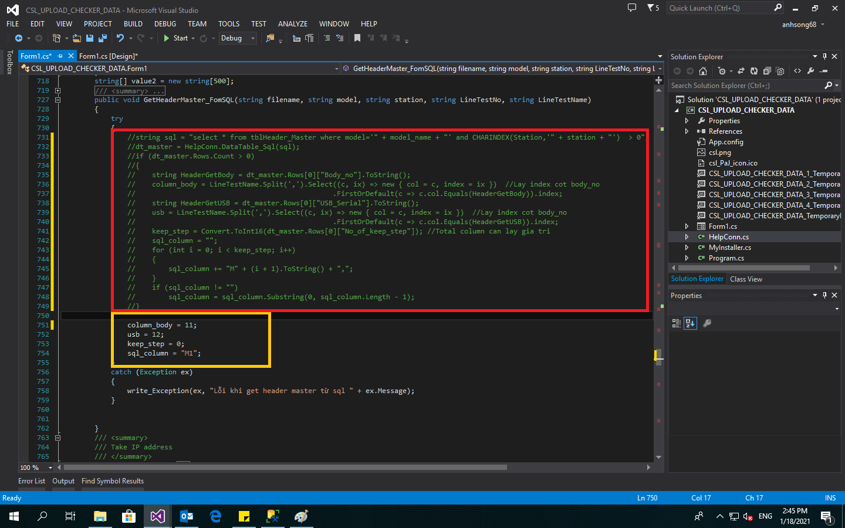
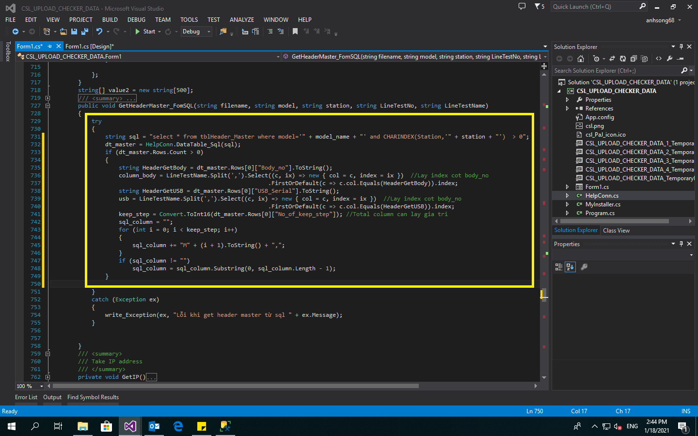
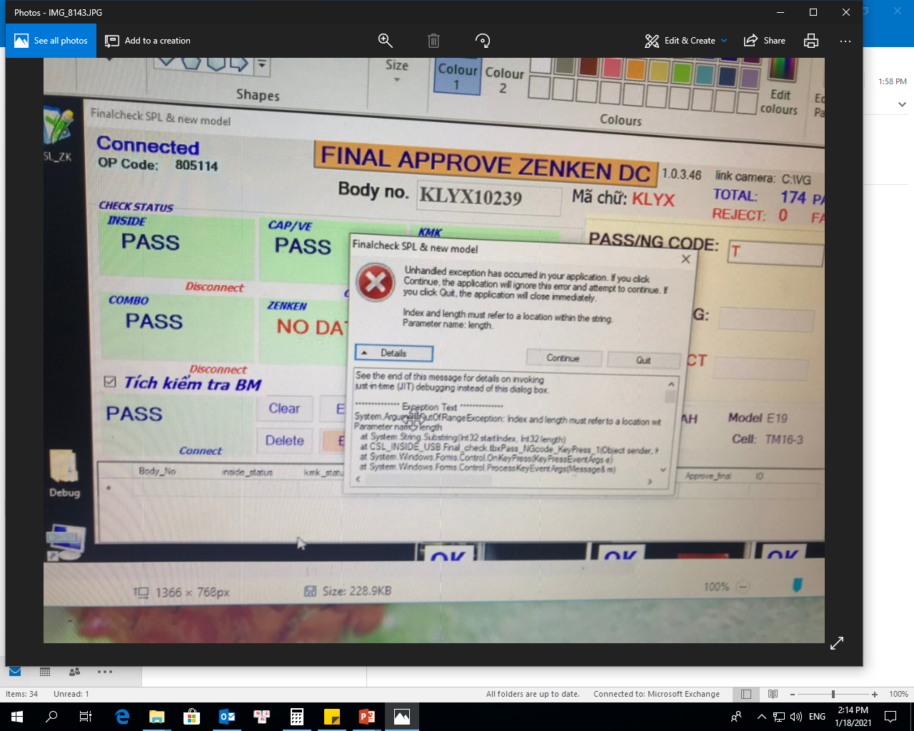
Review 2020
Check sheet less(Inkjet)
Code NG has been commented
When code not yet fixed, code run many steps
→ very slow
After fixed code, code run very fast
Make optimal program → reduce hang up

Slide 5
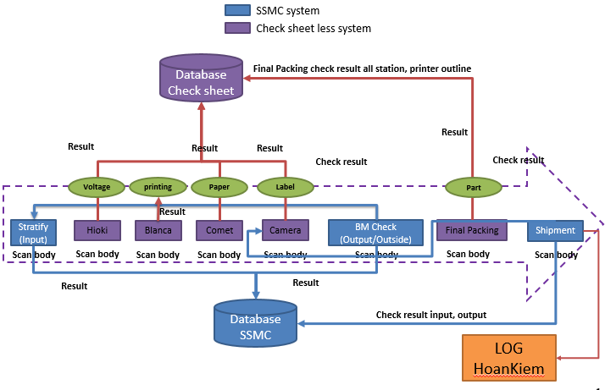
Review 2020
Check sheet less(LBP)

Slide 6
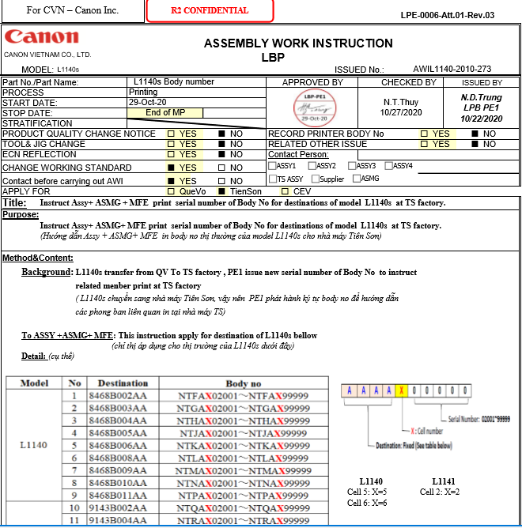
Review 2020
Follow new Destination or Model By AWI of PQA & PE

Slide 7
Review 2020
RPA
CVN
Div.2
CHAMP ROBOT(reduce 2.88 person workload)
Receiving Robot (Reduce 7.22 person workload)
Many robot from ACC,GIP,PDC1…
Auto Download data from NPIS(12h/month ,GM Award),
Take DSS from hoan kiem(8h/month),
Balance In-Out (180 minute/month)…
Video
Video Robot Auto Download Data from NPIS

Slide 8

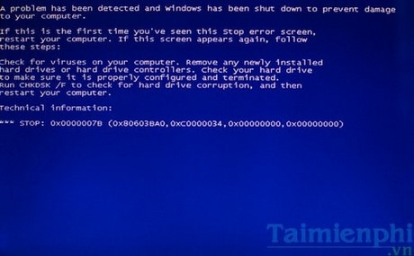

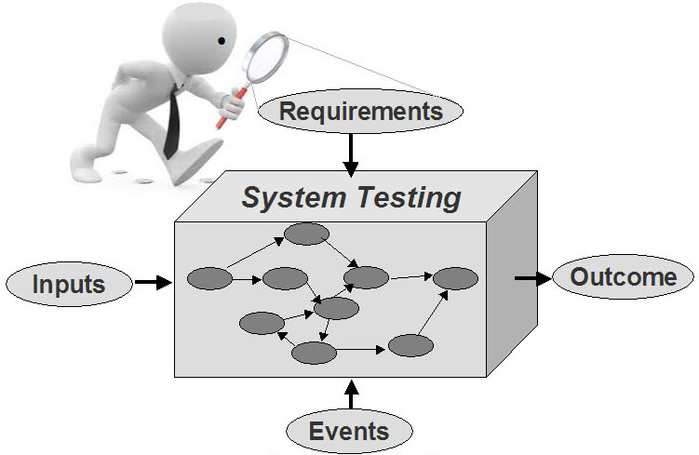
Action plan 2021
Check sheet less (Inkjet)
Improve programing skill
Limit system-related errors
combine multiple systems into 1 for easy error management
carefully check the system before going into use

Slide 9
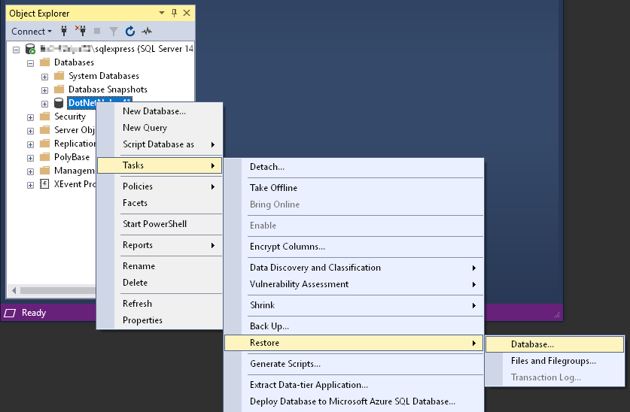
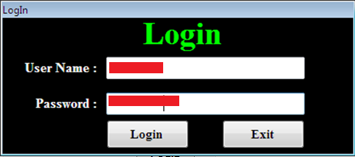

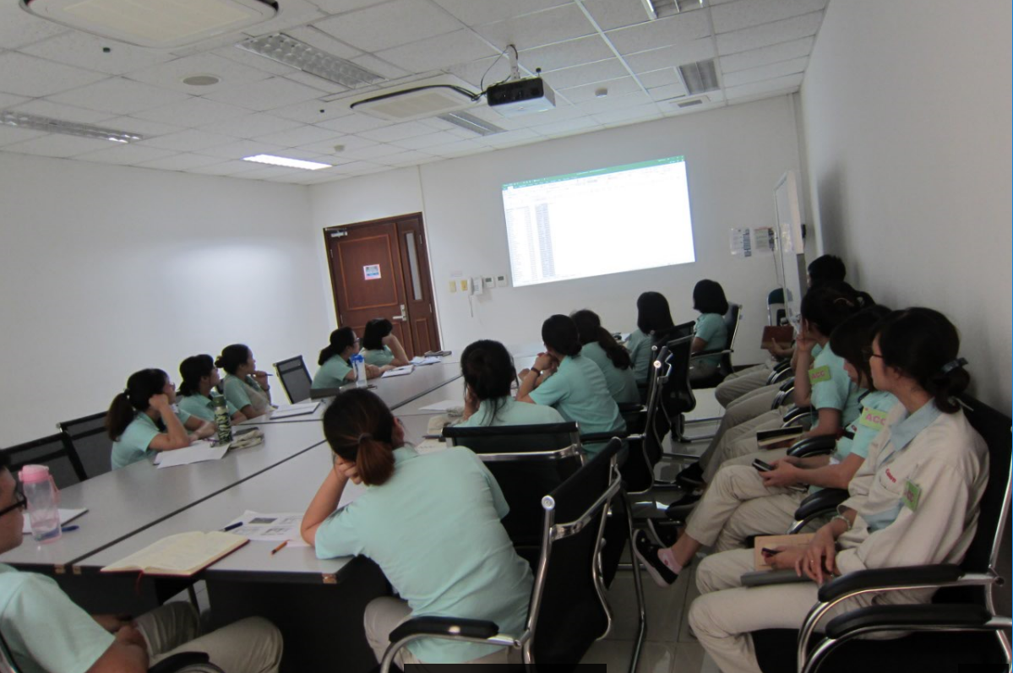
Action plan 2021
Check sheet less (LBP)
Prepare the database
Prepare setup system
Learn how to operate the system from the Philippines
Prepare Trouble list

Slide 10
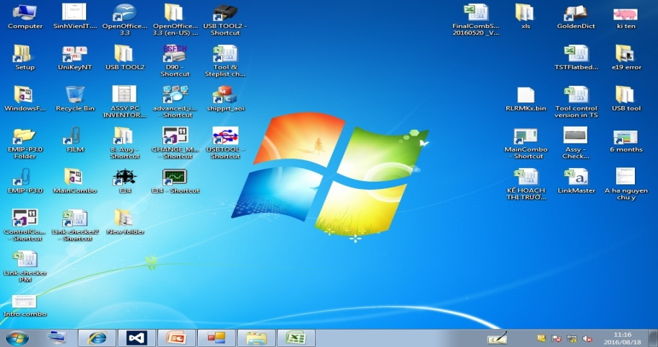

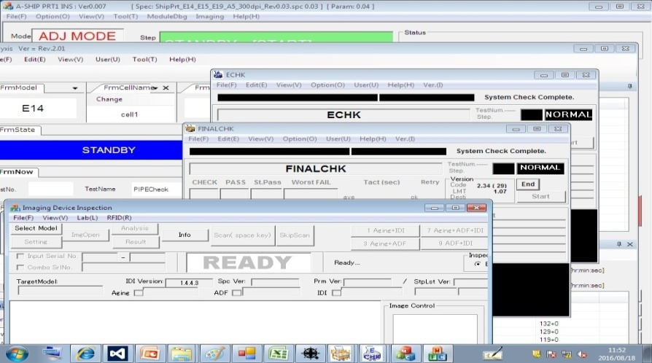
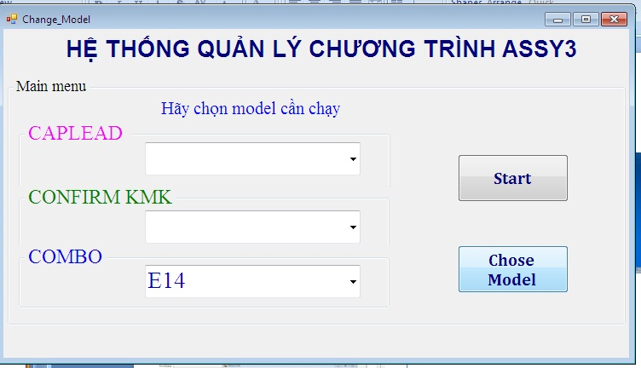
Action plan 2021
Auto Change Model
Before
After
5S Desktop
Click many times to “Close” all checkers
1 click to “Close” all checkers

Slide 11

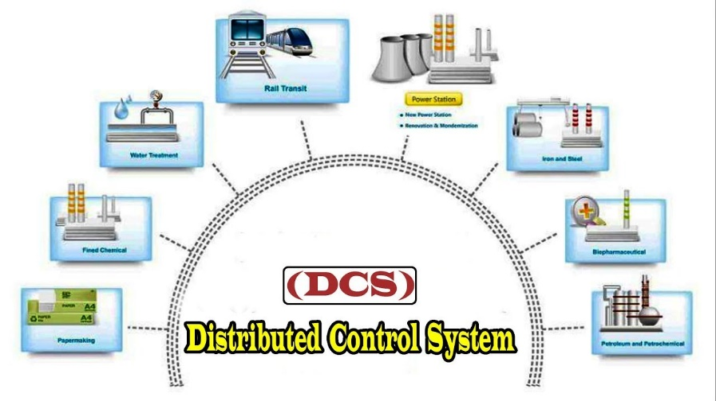





Action plan 2021
Auto Change Model
Benefit
Faster than human
Update PC by PC => muda times
(No need to pay salary)
Zero mistake
Auto update when Start PC
Compliance
Real time
Time Reduce=??? calculating

Slide 12

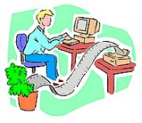
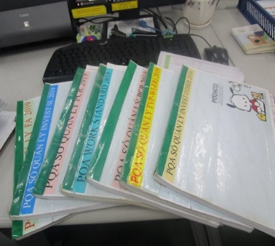
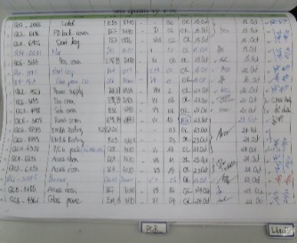

Action plan 2021
Approval document process
CURRENT METHOD
Current flow
Each dept – ONE document Carrier
Paper format issue
PROBLEMS
Takes a long time to get the information
Document maybe lost
Documents are difficult to control
Hand-writing (numbering, dating,….)
Document transfer record

Slide 13
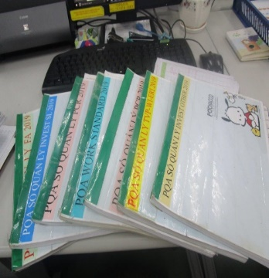
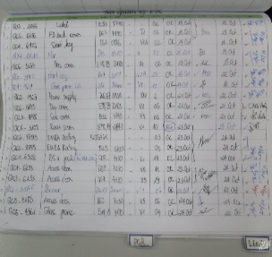
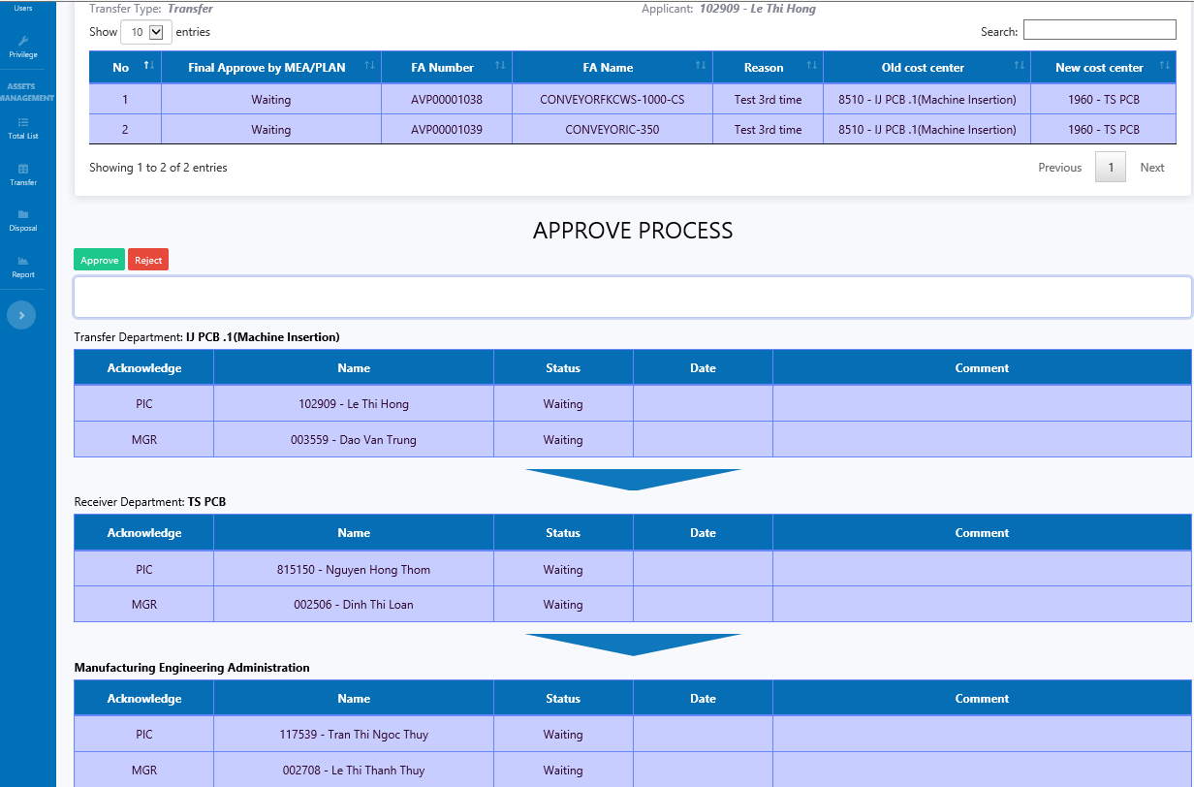
Action plan 2021
Approval document process
PQA
After kaizen flow
ASSY
MQA
Each dept – ONE document Carrier
Paper format issue
PE
Issue → Check → Approval: by SYSTEM
Hand-writing (numbering, dating,….)
Document transfer record

Slide 14
Action plan 2021
Approval document process
TS ASSY
TS PCB
TS PQA
3 Factory
Reduce 30m of land for TS ASSY 48h/month
1. Reduce paper (~ 800sheet/ month)
2. Reduce time to transfer document (~ 180min/month)
3. Reduce time scan WSD, save model by model (6h/month)
Reduce PQA (36h/month, 1000 sheet paper/month)
estimate 3 Factory 30 Dep't (1000h/month~5 person workload), Many Land free

Slide 15
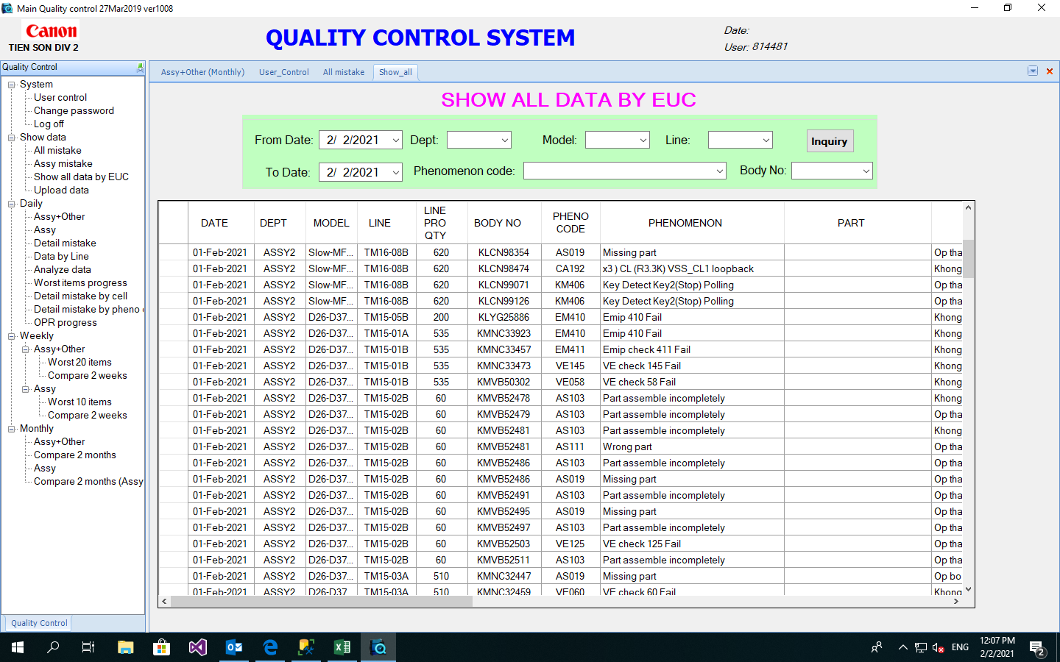
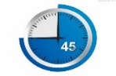
Action plan 2021
One part Rate (OPR)
Current flow
Muda time
Waiting for combination
Send to canon inc
Delay
Muda, Workload
Human download data from system
New Flow FM request
One click

Slide 16






Action plan 2021
Robotic process Automation
Virtual workforce 24x7x365
Productivity increase
Reduction of human errors
Flexibility
Cost reduction
Scalability
Make robot
Design New robot Apply and Follow test
04
Level 3
Introduction to UiPAth REFramework
Design robot: Order part from Thang Long
Design robot: UPDATE PURCHASE REPUEST
Design robot: Download quantity up paper file
analysis and prioritize
03
Level 2
Deploy and trigger a process
Publish a UiPath workflow
Create an environment
Job queue works, handling pending jobs, canceling and terminating jobs
Schedule jobs
Monitor of all Robots registered to the Orchestrator
Levels of error messages are communicated
UiPath Orchestrator Assets?
Store credentials in the Orchestrator
Use queues to work with lists of items that are handled by multiple Robots
Add items to queues and how to get transaction items
02
Level 1
Advanced UI Interaction
Selectors
Image & Text Automation
Advanced Citrix Automation
Excel & Data Tables
PDF
Email Automation
Debugging & Exception Handling
Project Organization
01
Level 1
Introduction
Variables, Data Types & Control Flow
Data Manipulation
Recording
Q1
Q2
Q3
Q4
Q1
Q2
Q3
Q4
Q1
Q3
Q4
11.Apr.21
30.Apr.21
15.May.21
15.Jun.21
Dec.21-

Slide 17
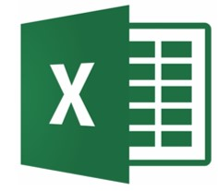
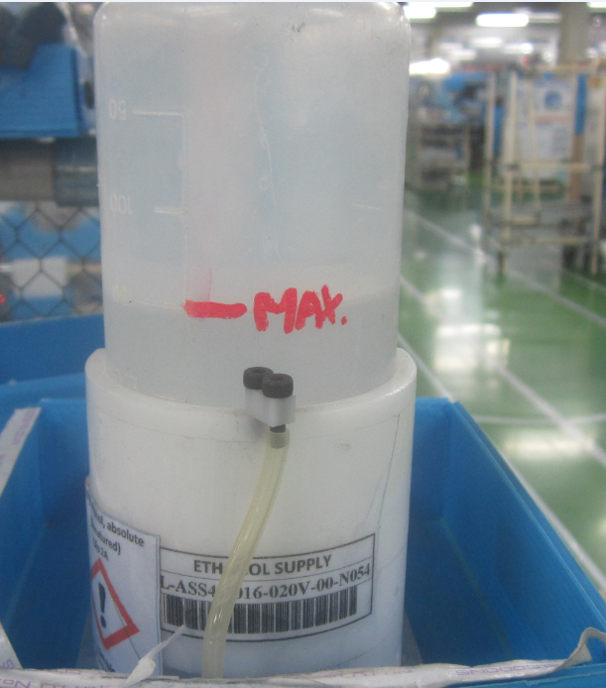

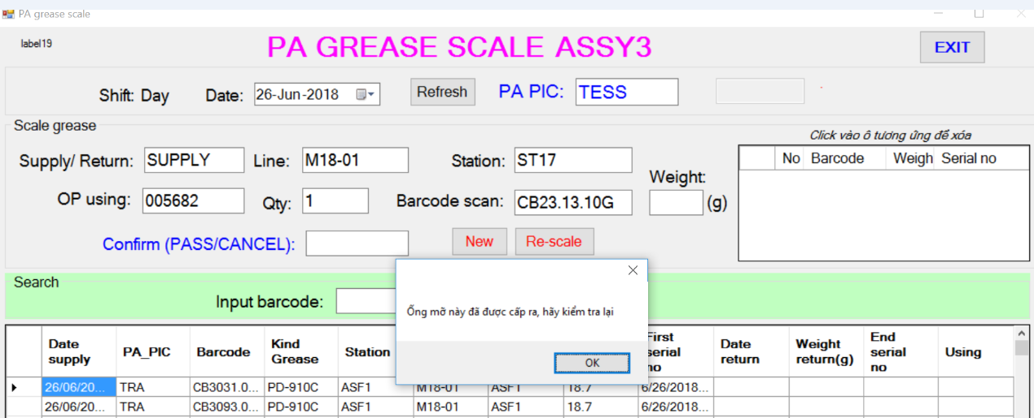
Action plan 2021
Grease control (Station by Station)
Before
Control by excel file
Calculate the total amount of grease used by volume
enter grease into the tube
At the end of the day return grease and calculate the output into excel file
After
1. OP san barcode, the system automatically receives the data
2. Daily aggregate data according to actual production line output
3. Manage usage by station by station, cell by cell => detect abnormal daily usage
4. Data reported according to each type of fat, station, cell, day, month

Slide 18
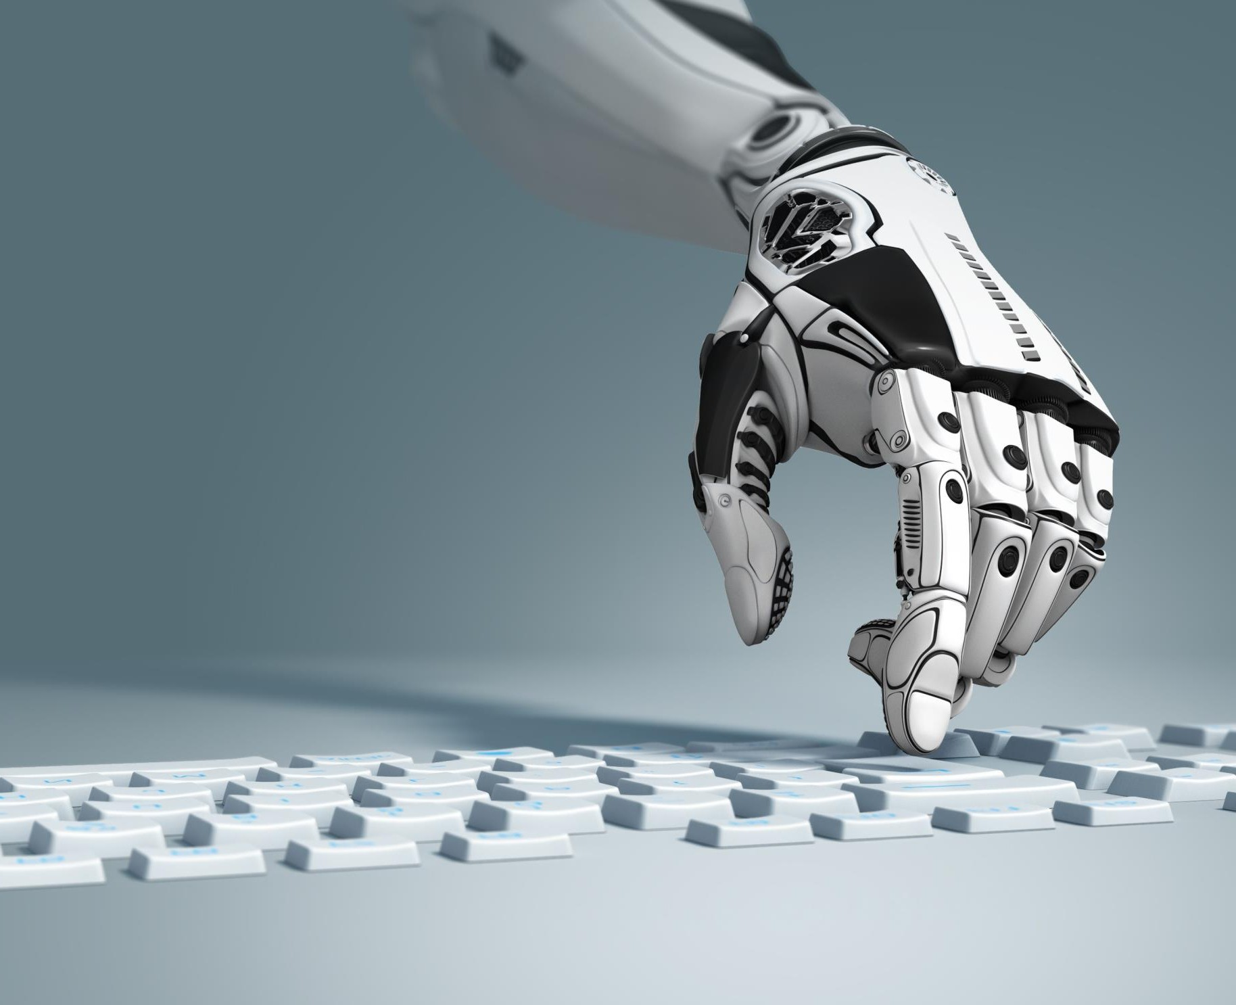
Thank you !

